Slide 1
book2
File created on: 11/5/2022 5:02:13 PM

Slide 2
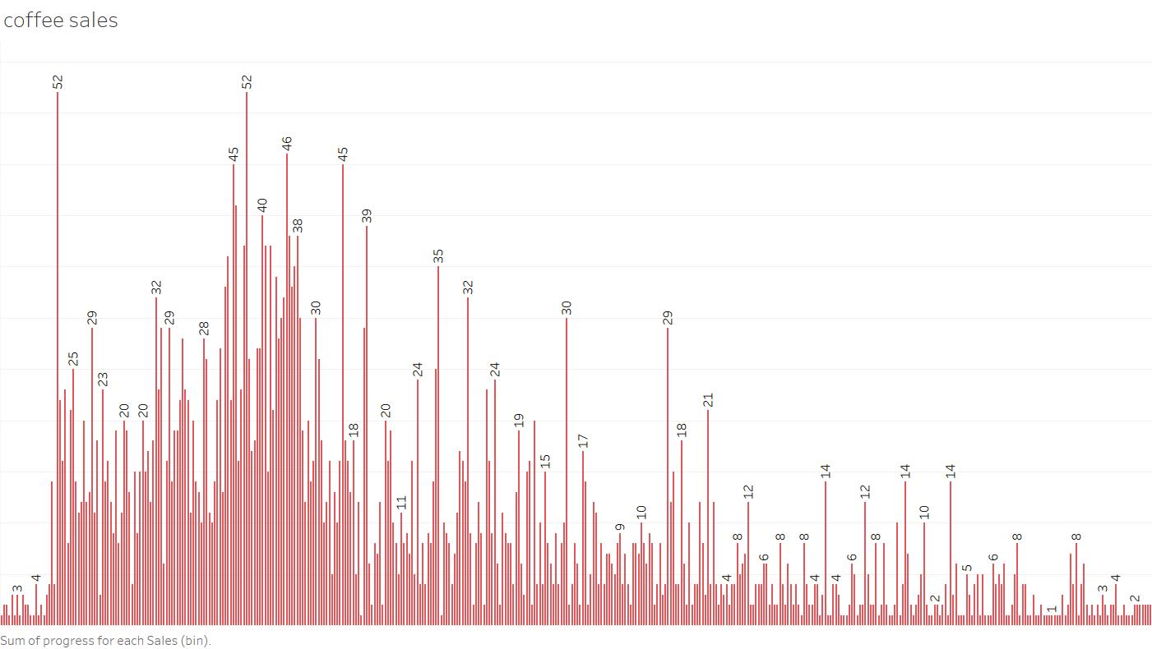

Slide 3
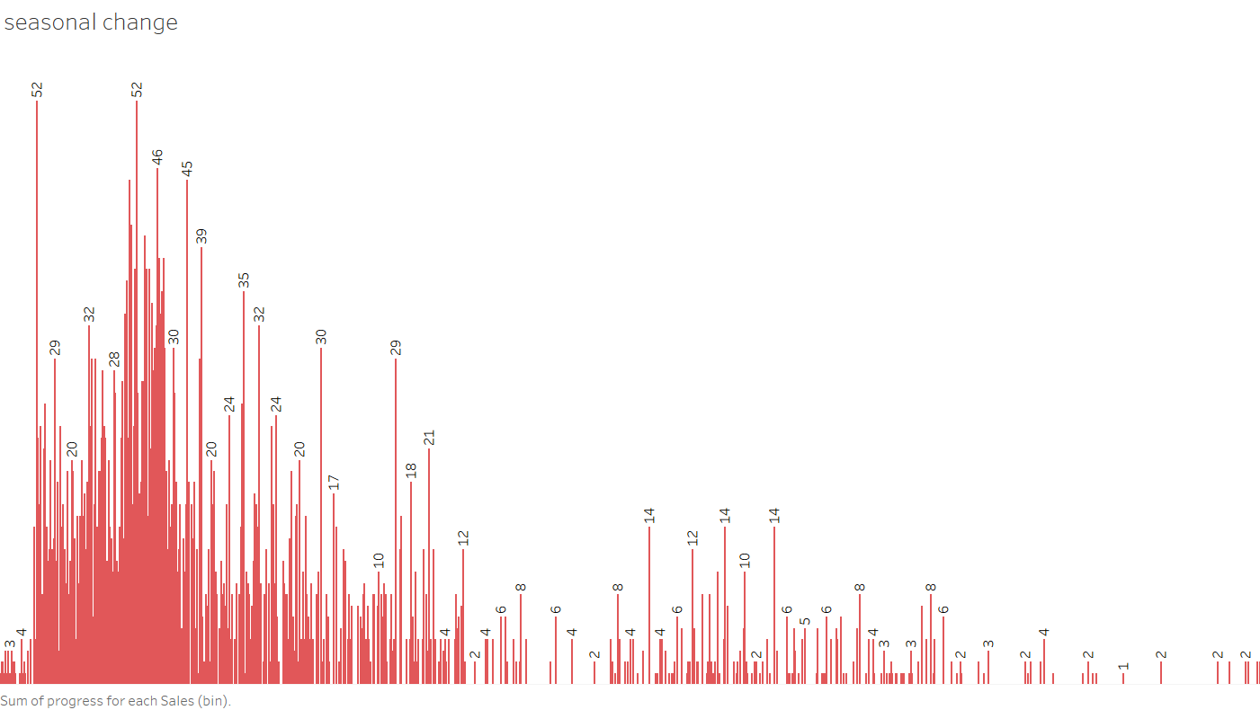

Slide 4
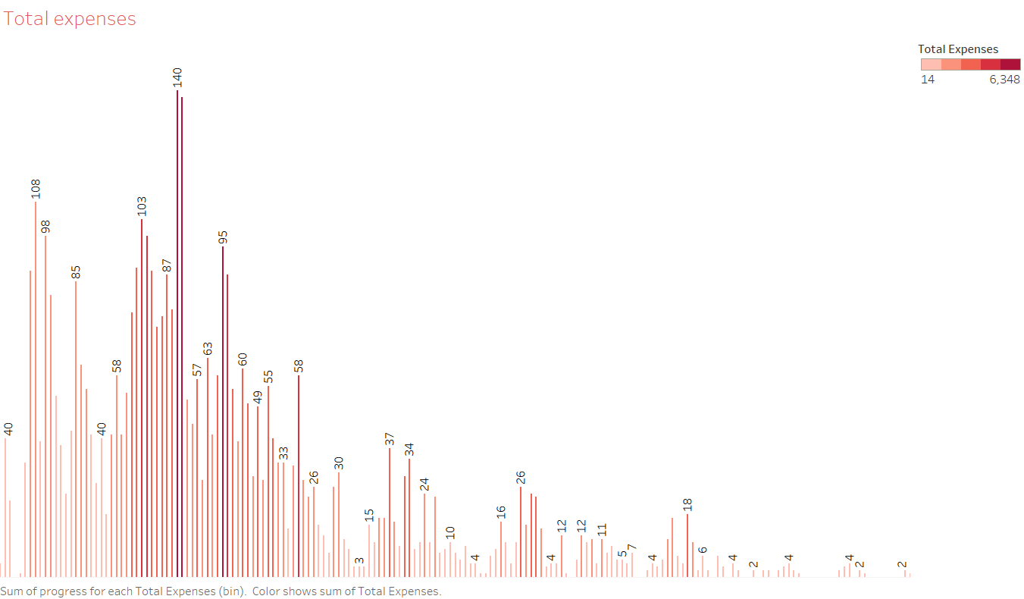

Slide 5
